Slide 1

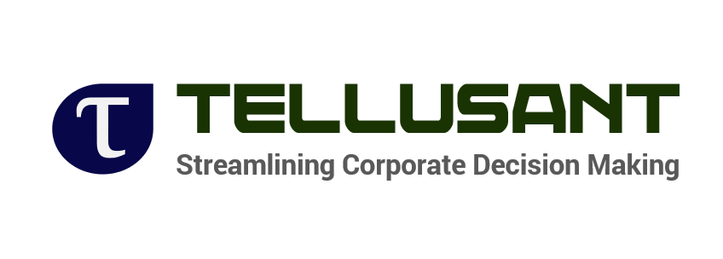
Introduction to Tellusant
2024

Slide 2
Introduction
Tellusant, established in 2020,
was born with a bold vision: to transform global corporate decision-making using
SCIENTIFIC APPROACHES
to tackle management issues.
Today, that vision is becoming a reality.
We offer a range of
CLOUD-BASED PRODUCTS,
serve clients around the world and have earned an outstanding reputation in the corporate sector.
Our founders were uniquely qualified to achieve this, bringing strong top management connections, cutting-edge intellectual property, and
EXTENSIVE GLOBAL MARKET EXPERIENCE.

Slide 3
Agenda
1 | Tellusant Overview
2 | Examples of Impact
3 | Complete Process Example
4 | Conclusions

Slide 4







Tellusant revolutionizes strategy by automating core analyses and processes
TelluBase
Unique subnational consumer classes hub across 218 countries, 2,600 cities and 25,000 sub-divisions from 2000 to 2050
Tellusant delivers
quantitative strategic prediction platforms with AI streamline strategy through:
PoluSim
The leading strategic forecasting tool providing detailed internal and competitor predictions with scenarios
Faster decision-making
PACE
Increased accuracy
The only tool that quantifies market opportunities to identify and capitalize on untapped potential
Consistent outcomes
Products available as subscriptions and are used in our strategy consulting work

Slide 5











Tellusant provides expertise in strategy development and streamlining decisions
Over 300
strategic solutions delivered
92 countries
On-the-ground expertise from work in 92 countries, with work in 119 countries
11 of 20 largest consumer goods companies
Worked with and are trusted by 11 of the top 20 consumer goods companies in the world

Slide 6
Agenda
1 | Tellusant Overview
2 | Examples of Impact
3 | Complete Process Example
4 | Conclusions

Slide 7

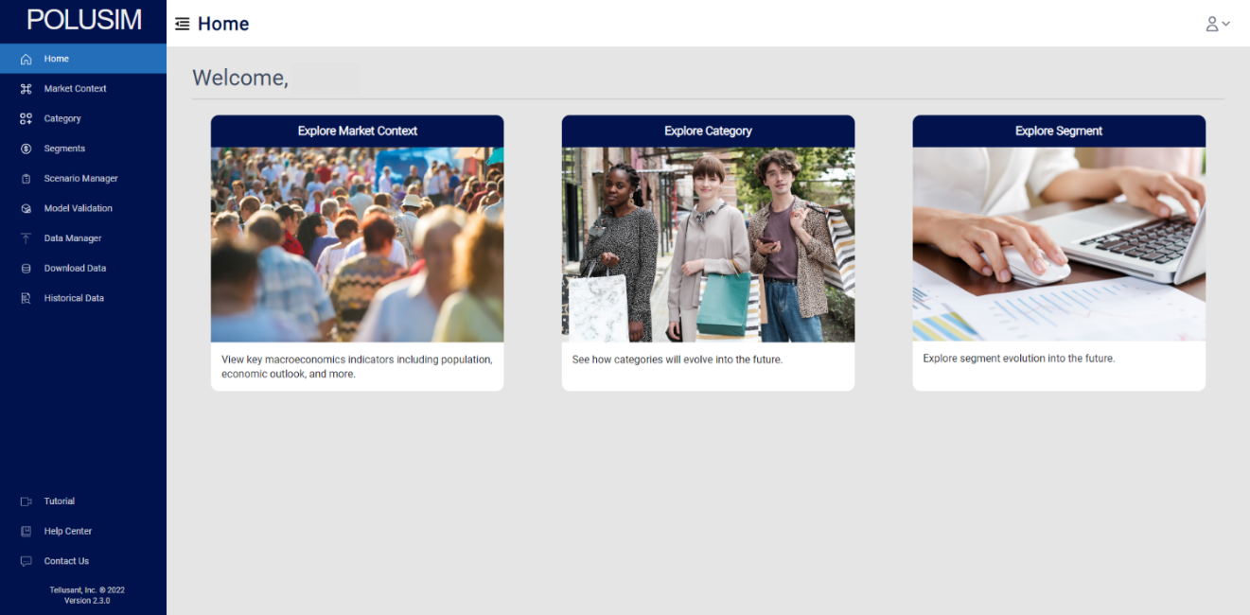
PoluSim makes strategic forecasting effective
Get robust, explainable forecasts with customizable drivers, allowing users to review forecasts, refine assumptions
So you can focus on strategic implications
Strategic Forecasting facilitates corporate strategic decisions based on quantitative predictions that are harmonized across an organization
Backed by

Slide 8
Strategic forecasting is critical to success but works poorly
EFFECTIVENESS OF STRATEGIC FORECASTS
From Tellusant survey of executives at large consumer-facing companies
85% of respondents find value in strategic forecasts
But over 60% find the process does not work

Slide 9
“
Most of executives’ time is spent on checking the analysts’ numbers rather than thinking about the issues
“
– Head of Strategy at $40 B company
Today each unit harmonizes and forecasts data it in a way that makes it look good. There is not one version of the truth”
– CFO of US business unit with 60,000 employees

Slide 10

Direct cost benefits provide minimum 4x ROI
The average company using PoluSim has seen direct cost savings of
430%
PoluSim enables best-in-class strategic forecasting
on a three-year basis
Facilitates precise prediction of product performance trends
Ensures a consistent understanding of performance metrics across business units
Helps identify growth opportunities and integrate them into strategic planning
And more
“
“We transitioned all strategic forecasting to PoluSim, which empowered each of our business units to build forecasts quickly and with sound judgement”
- Chief Marketing Officer, USD 800 million food company

Slide 11
We work with you to harmonize data and improve accuracy by at least 20%
We build customized harmonization setups depending on availability and trust in data
ERROR IN SOURCES VS FINAL SOURCE OF TRUTH
Absolute average error across 11k category data points of volume and value data
Internal market estimates
Company data
3rd party data
Syndicated data
Government information
Public sources

Slide 12
Understand where the gaps of consumption are across types of consumers
Problem: Traditional gap analyses often overlook detailed consumer segmentation by focusing mainly on total market size, making it challenging to pinpoint under or overserved consumer groups
Solution: The PACE product provides detailed insights into how much each consumer segment could potentially spend
Consumption per capita
South Africa Beer Consumption
Tanzania Beer Consumption
Consumers in South Africa are spending close to as much as they reasonably can afford
Darker shades represent current consumption
Lighter shades represent maximum consumption
Income of consumer
Income of consumer

Slide 13
PACE identifies pockets of opportunity with precision
Problem: Looking only at population and / or GDP provides a limited view of what a true relevant consumer base looks like
Solution: By deploying the PACE product, Tellusant enhances internet access targeting by connecting with consumers more effectively than using population data alone, predicting internet accessibility in over 20 subnational locations with remarkable 80x accuracy
ACCURACY OF MEASURE AT PREDICTING INTERNET ACCESS IN SUBDIVISIONS
Expressed as percentage of variation explained
Peak Target Consumption

Slide 14
Agenda
1 | Tellusant Overview
2 | Example of Impacts
3 | Complete Process Example
4 | Conclusions

Slide 15

Five key steps to strategic forecasting with PoluSim
Managed by Tellusant
Aligned with company
Always available in PoluSim
Base Forecasts
Based on consistent, proven demand drivers
Updated 2-4x per year
Forecast Enhancements
Tellusant updates to forecasts and PoluSim
Updates not required
Scenarios
Baseline scenarios provide realistic ranges
Based on economic conditions, consumer trends (customized)
Fully Custom Forecasts
Updated anytime
Baseline Forecasts
Managed by company
Support available from
Tellusant
Company Alignment
Adjustments transparent to all
Teams Add Adjustments
Determine most realistic scenarios
Add flexible adjustments

Slide 16
Companies today struggle with many forecasting issues
GDP growth predicts next few years
Next few years will be like past few years (taking out pandemic effect)
Predictions by syndicated data providers
Own growth projected without regard to total category
Many drivers fine-tuned by a specialist, but without scientific base
Inconsistent methods across business units
Tellusant’s Strategic Forecasting process and tools solves these and other forecasting issues

Slide 17




We develop strategic forecasting excellence in 4-phases
Combine Tellusant external sources and client data
Build a single version of the truth
We often find 10%+ discrepancies in data that are harmonized
1. Establish Facts
PROCESS IN ACTION
Case study client
Fast-moving consumer goods with global operations, USD 20 B in sales
Project overview
Forecasting process was done as a business unit level inconsistently by methods, granularity, and reliability
Client wanted to have forecasts that it could use across organization and global could believe / understand
Long-term goal to build a strong strategic forecasting capability in business driven by CEO
Evaluate potential drivers of demand
Build list of proven drivers
Measure how drivers interact and could influence the future
Services and Product Installation
2. Understand Drivers
Incorporating drivers, build forecasts in PoluSim
Refine forecasts and build alternative scenarios
Evaluate impacts of forecast insights
3. Develop Strategic Forecasts
Product Subscription and Support
Training of PoluSim to run scenarios consistently
Build consistent method for evaluating strategic forecasts
Knowledge center and continuous improvement setup
4. Integrate Processes

Slide 18
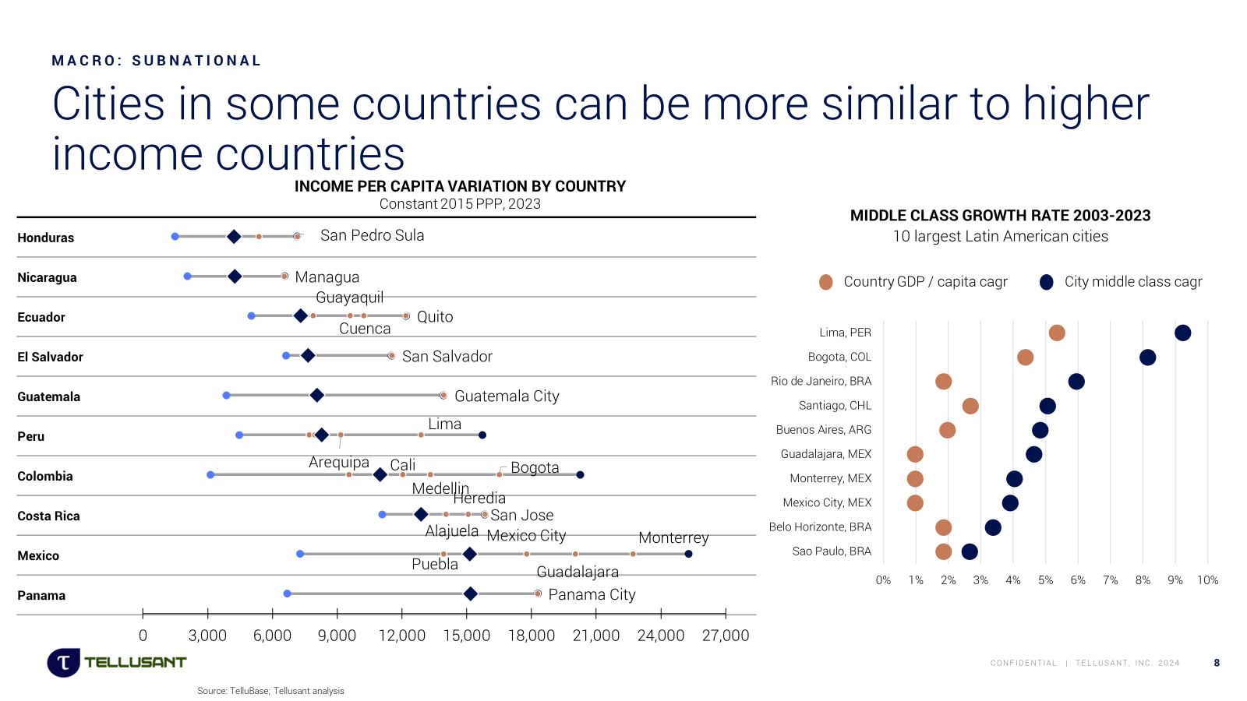
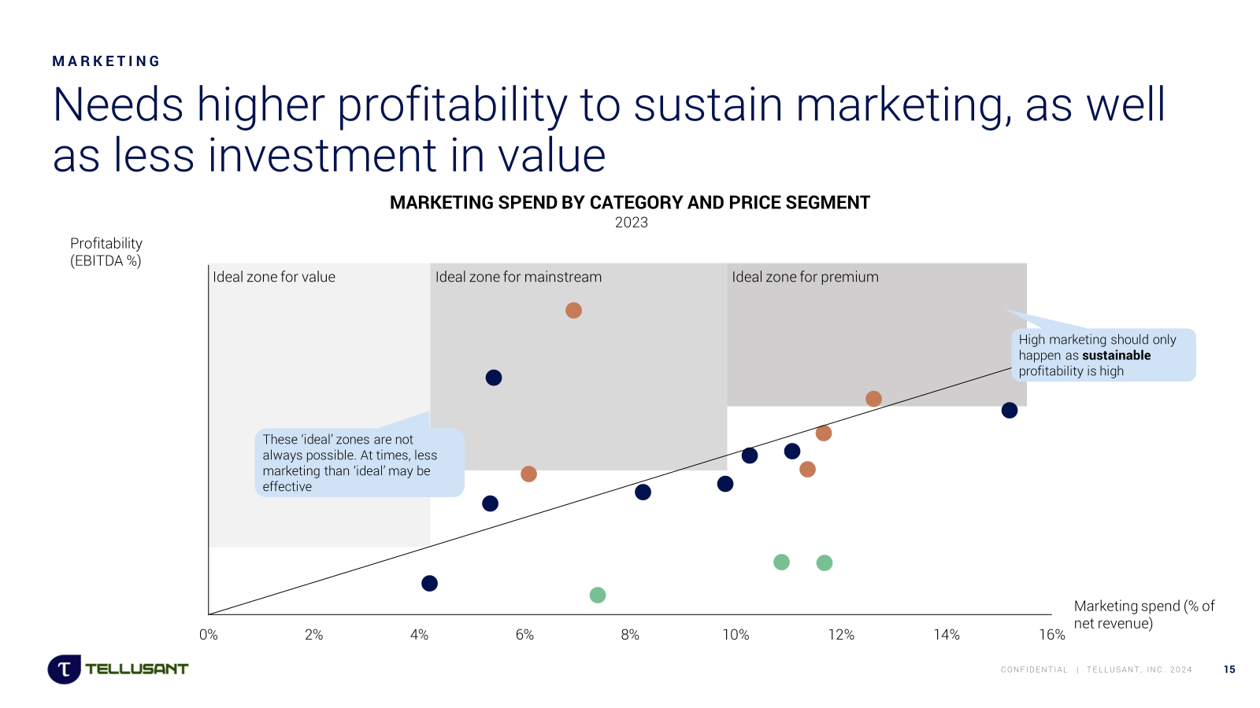
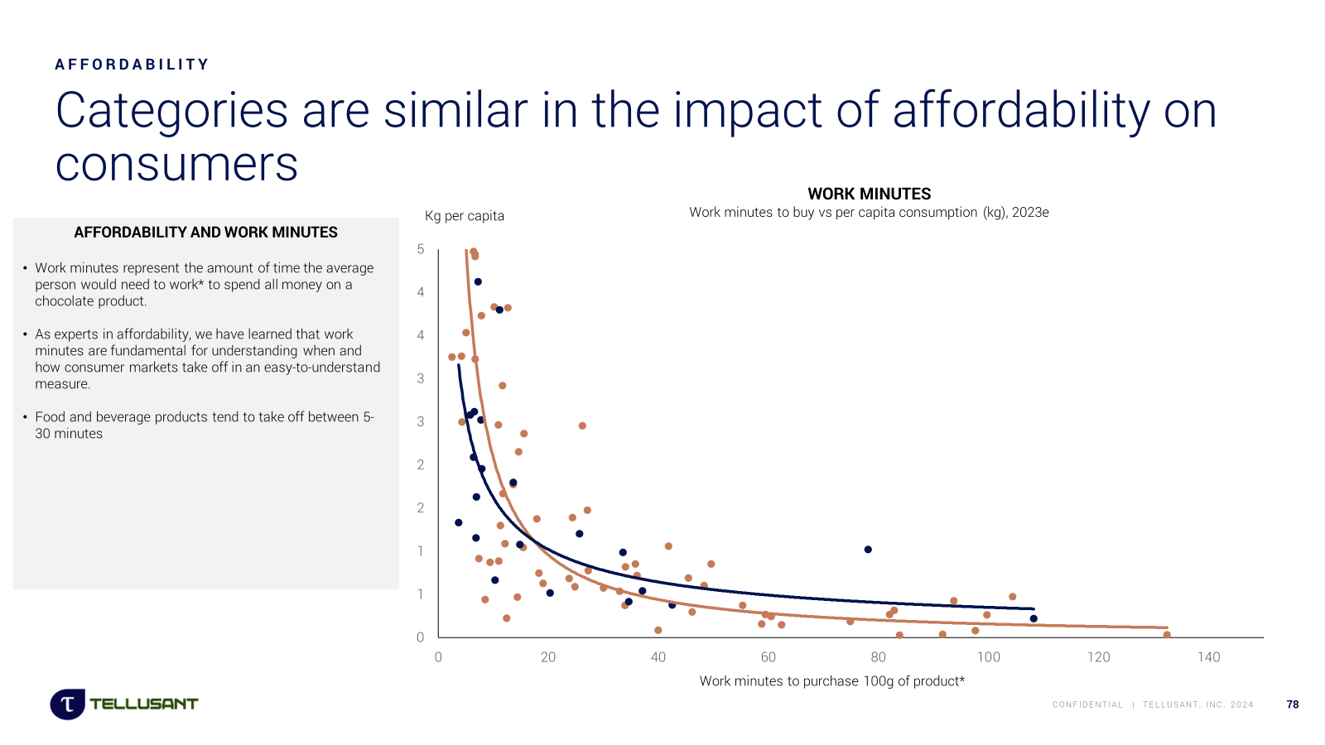
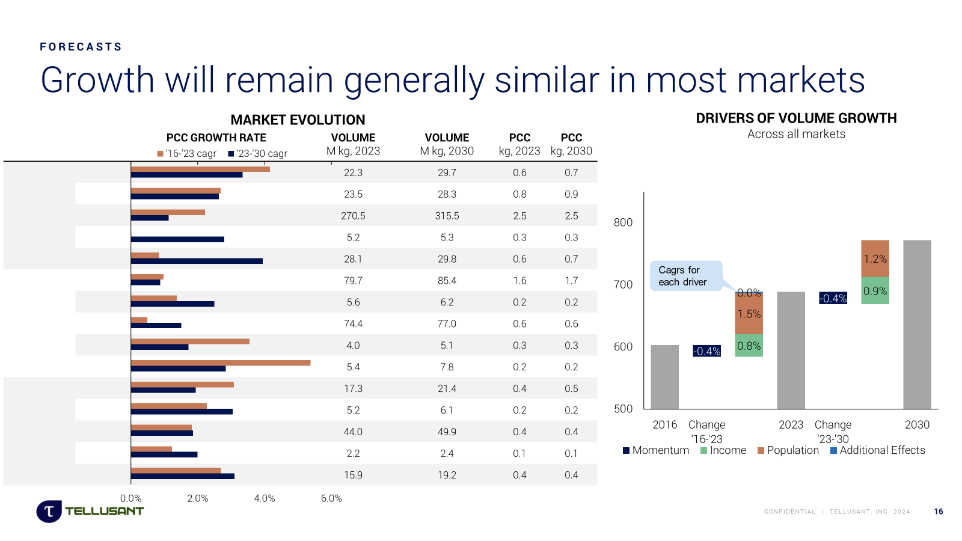
Our rigorous and data-driven process measures demand precisely into the future
Economics &
Demography
Industry & Trade
Consumer Insights
Drivers of consumption span across economic, consumer, and player action driven factors, which vary by time and as markets evolve
We organize the variables through a Golder Tellis predictive framework:
PROCESS IN ACTION
From case-study client
We identified 5 key drivers that explain >95% of demand and a total of 15 relevant drivers
Impact and relevance of drivers is explained and can be used across organization
Using TelluBase, several business units started viewing markets subnationally (by region / city) in terms of drivers and forecasts

Slide 19
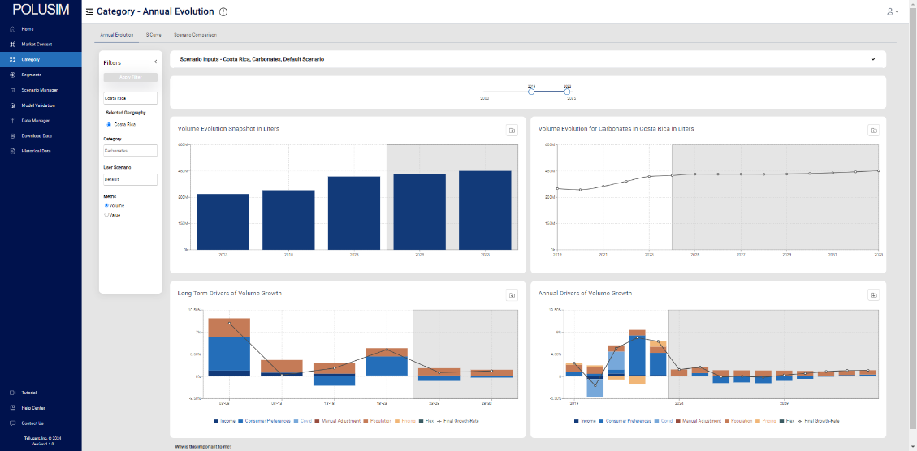
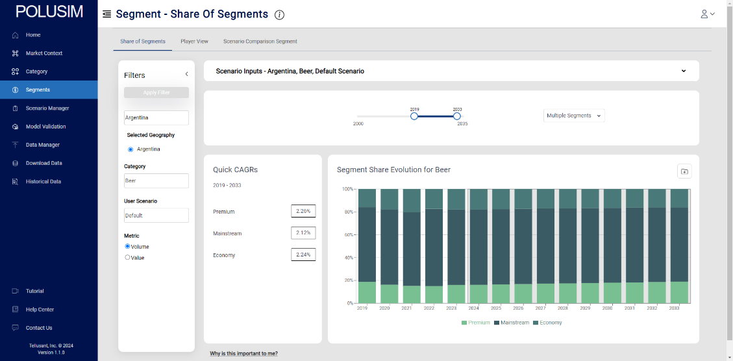
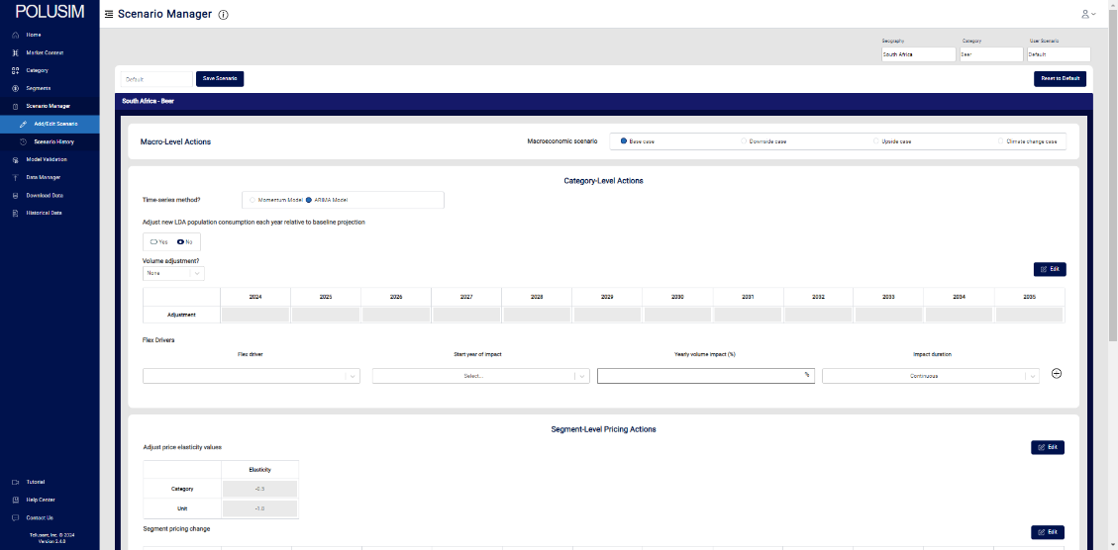
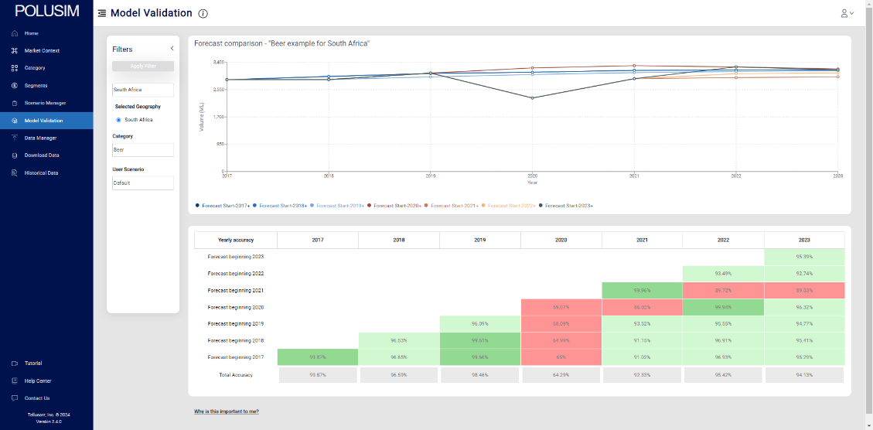
PoluSim allows clients to continuously update insights
Forecasts updated as new information comes in and managed across local, regional, and global teams in an accountable and consistent manner
Insights tied with templates for use within presentations
PoluSim serves as a hub for data-driven decision making
PROCESS IN ACTION
From case-study client
PoluSim provides unlimited flexibility in building scenarios for alternative and unforeseen shifts
Training, installation, and integration process took place over 6 months
PoluSim access provided to 1-2 team members per business unit and headquarter functions

Slide 20
Outcomes increase decision efficiency and lower costs
IMPACT
Ability to understand future trends in markets
Know why trends are happening
Explain what is causing trends
Consistent view of key dynamics related to consumer demand
Ability to make rational adjustments in forecasts based on market factors and strategic decisions
Tool provides scenario management
Transparency in adjustments increases believability
Clear connection to tie forecasts with strategy
Forecasts tie directly with strategic planning, strategy development
Consistency across business units drives comparability and effectiveness for leadership
IMPACT IN ACTION
From case-study client
Data accuracy increased significantly. Most sources used had 5-10% inaccuracy that was fixed during effort
Time to build forecasts for strategic planning is reduced by 75%
Forecast accuracy increased by 50%
Additional strategic initiatives launched due to new access to information and insights within PoluSim

Slide 21
Agenda
1 | Tellusant Overview
2 | Examples of Impact
3 | Complete Process Example
4 | Conclusions

Slide 22
Tellusant delivers three tiers of benefits from its products
BENEFITS
Streamlined decision making
Be agile and precise with strategic decisions
Tellusant’s long-term vision
Upgraded strategic forecasting process
Become a strategic forecasting leader
Products used without change in processes
Gain direct cost benefits
Our initial involvement typically starts with a basic installation, evolving as client satisfaction and ambitions grow

Slide 23
Success Stories: Leveraging PoluSim across varied business needs
Company Revenue and Reach | Previous Strategic Forecasting Capability | Rationale for PoluSim
$40bn, Global, 40 business units (BUs) | Internal (data team), strategy consultants | Data team forecasts were unreliable, not trusted by any business units
$20bn, Global, 100 BUs | 3rd party data provider, strategy consultants | Desire to become a leading strategic forecasting company to better plan
$9bn, USA, 3 BUs | Internal (data science team) | Need to upgrade forecasting to be state-level and capture consumer trends
$2bn, Global, 15 BUs | Internal (incomplete, not used) | Strategic project to determine future category evolution Followed by PoluSim access
$750m, Latin America, 5 BUs | 3rd party data provider only | Component of effort to advance capabilities in strategic planning
$500m, Mexico, 1 BU | 3rd party data provider only | Strategic project to find market opportunities. PoluSim provides subnational insights

Slide 24
How to work with us
A. Deep dive to assess the opportunity for strategic forecasting in your organization
B. Begin implementation of PoluSim or PACE
C. Access TelluBase information and work with us to learn how to best use it
D. Strategic projects relating to strategic forecasting
E. Work in parallel with consultants as the experts in strategic forecasting
F. Discuss how we can help you

Slide 25
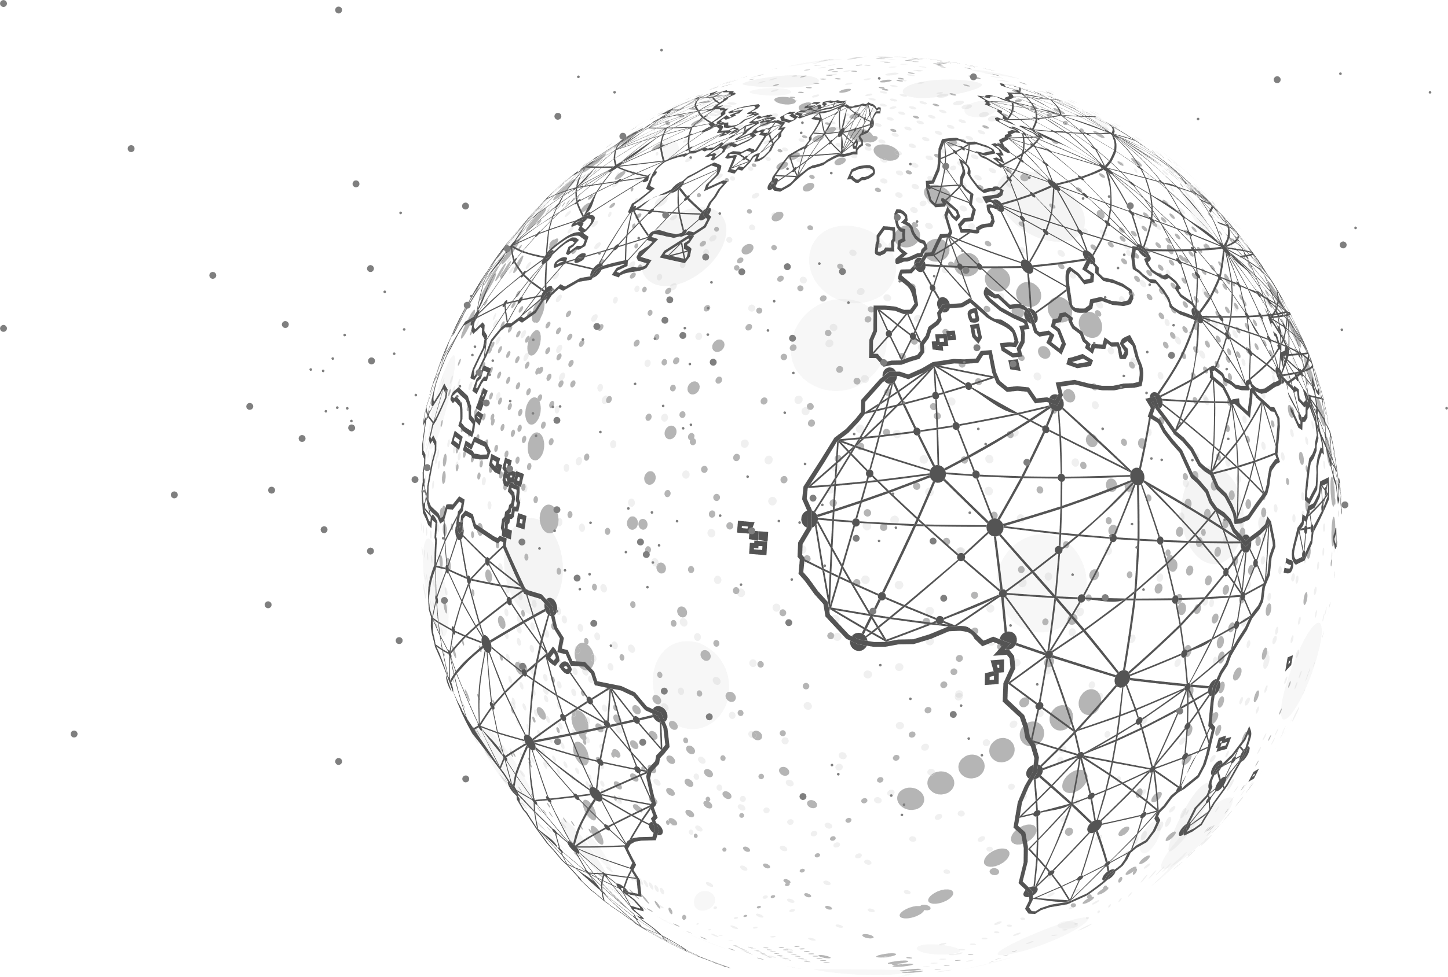
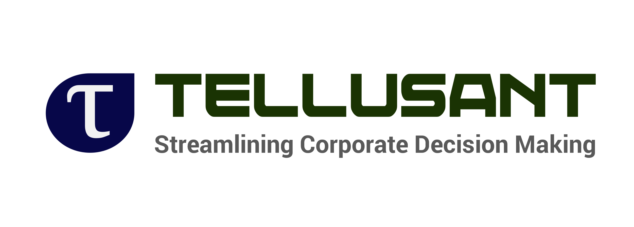
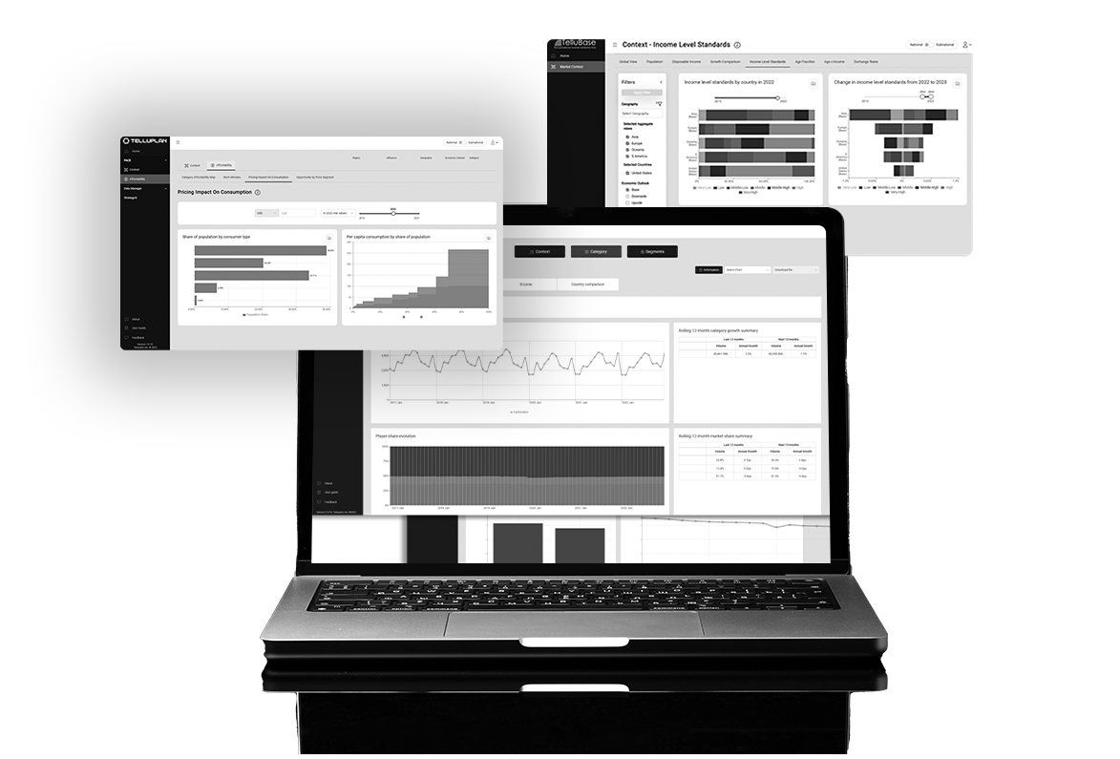
240 Elm Street, Suite 200, Somerville MA 02144, USA
Paseo de la Reforma 509, Piso 16, Cuauhtémoc, Ciudad de México 06500, Mexico
+1-617-394-1800

